Slide 1
Calculating missing lengths with perimeter of polygons
Perimeter and area

Slide 2
how to use Oak lessons

Slide 3
I can use the properties of a range of polygons and the perimeter of a given polygon to deduce missing side lengths.

Slide 4
A polygon is a flat (2D), closed figure made up of straight line segments.
The perimeter is the distance around a 2D shape.

Slide 5

Calculating missing lengths with perimeter of polygons
Calculating unknown lengths
Problems in context

Slide 6
Calculating unknown lengths
Unknown lengths can be calculated using the perimeter and any properties of the polygon.
The perimeter of the rectangle is 42 cm. How might you work out the unknown length?
w
6 cm

Slide 7
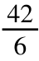
Calculating unknown lengths
Perimeter = 42 cm
w
Discuss each approach
6 cm
Alex’s approach:
Jacob’s approach:
Izzy’s approach:
6w = 42
w =
w = 7
w + 6 + w + 6 = 42
2w + 12 = 42
2w = 30
w = 15
w + 6 = 21
w = 15

Slide 8
Calculating unknown lengths
Perimeter = 42 cm
w
Discuss each approach
6 cm
Alex’s approach:
E.g.
This is not how you calculate perimeter.
This is how you find the area.
6w = 42
w =
w = 7

Slide 9
Calculating unknown lengths
Perimeter = 42 cm
w
Discuss each approach
6 cm
Jacob’s approach:
Izzy’s approach:
E.g.
Both approaches work.
I like Izzy’s better as it is more efficient.
w + 6 + w + 6 = 42
2w + 12 = 42
2w = 30
w = 15
w + 6 = 21
w = 15

Slide 10

Calculating unknown lengths
To work out an unknown length in a regular polygon, I just need the perimeter.
All the sides are the same length so divide by the number of sides.

Slide 11
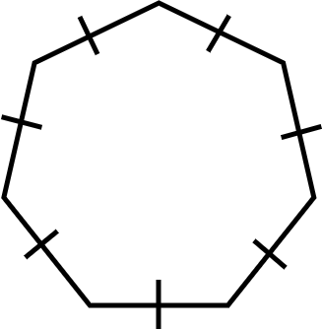
Calculating unknown lengths
The perimeter of the heptagon is 112 mm.
What is the length of one side?
112 = 7 × side length
16 mm = side length

Slide 12
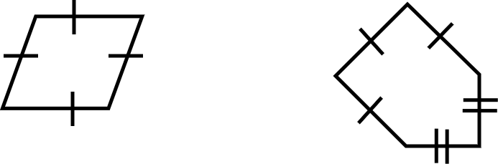
Calculating unknown lengths
1) Calculate the lengths of the marked sides.
a) b)
7 units
b
a
Perimeter = 10 units Perimeter = 25 units

Slide 13
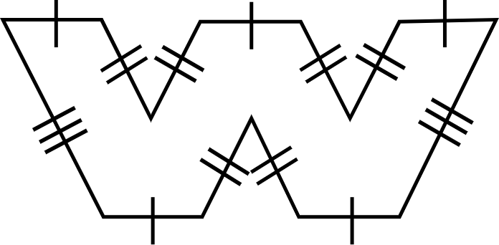
Calculating unknown lengths
1) Calculate the lengths of the marked sides.
c)
c
9 m
4 m
Perimeter = 74 m

Slide 14
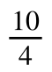
Calculating unknown lengths
1) Calculate the lengths of the marked sides.
a)
a + a + a + a = 10
4a = 10
a =
a = 2.5
The length of the marked side is 2.5 units.
a
Perimeter = 10 units

Slide 15
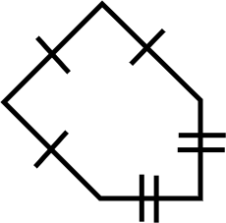
Calculating unknown lengths
1) Calculate the lengths of the marked sides.
b)
7 units
7 + 7 + 7 + b + b = 25
21 + 2b = 25
2b = 4
b = 2
The length of the marked side is 2 units.
b
Perimeter = 25 units

Slide 16
Calculating unknown lengths
1) Calculate the lengths of the marked sides.
c)
5 × 4 + 2 × 9 + 6 × c = 74
20 + 18 + 6c = 74
38 + 6c = 74
6c = 36
c = 6
The length of the marked side is 6 m.
c
9 m
4 m
Perimeter = 74 m

Slide 17
Calculating missing lengths with perimeter of polygons
Calculating unknown lengths
Problems in context

Slide 18
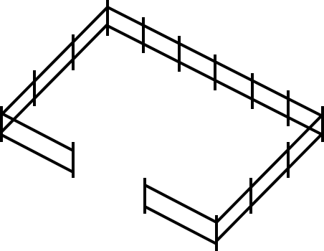
Problems in context
Farmer Sam is creating a rectangular paddock for their sheep.
The paddock needs a gate. Unfortunately, Farmer Sam forgot to measure the gap in the fence. List the different ways you could calculate the length of the gate.
gate

Slide 19
Problems in context
Farmer Sam is creating a rectangular paddock for their sheep.
List the different ways you could calculate the length of the gate.
gate
E.g.
Measure the gap in the fence.
If you knew the perimeter of the paddock and the length of all the fence, you could find the difference.

Slide 20
Problems in context
Farmer Sam is creating a rectangular paddock for their sheep.
Farmer Sam knows the paddock has a length of 90 m and a width of 45 m.
gate
What can you calculate using this information?
I can calculate the perimeter of the paddock.
The perimeter of the paddock is 2(90 + 45) = 270 m

Slide 21
Problems in context
Farmer Sam is creating a rectangular paddock for their sheep.
Farmer Sam knows the total length of fencing they used was 195 m.
gate
What is the length of the gate that Farmer Sam needs?
The length of the gate is 270 - 195 = 75 m

Slide 22
Problems in context
When dealing with a context based problem, it can be beneficial to think about what you could work out if you had the relevant information.

Slide 23
Problems in context
Perimeter calculations are not only used for this context. There are many different contexts in which you may need to work with the perimeter of a shape.
E.g. Skirting board around a floor (what is the length of the gap for the door?)

Slide 24
Problems in context
1) Write your own problem using the same measures but in a different context.
Length = 90 m
Width = 45 m
Perimeter = 270 m

Slide 25
Problems in context
1) Write your own problem using the same measures but in a different context.
Length = 90 m
Width = 45 m
Perimeter = 270 m
Answers will vary here but should all involve a perimeter of 270 m, a total known length of 195 m and an unknown length which equates to 75 m.

Slide 26
Calculating missing lengths with perimeter of polygons
Unknown lengths can be calculated using the perimeter and any properties of the polygon.
It can be helpful to consider what you could work out if you had particular information for a given problem.

Slide 27

© Oak National Academy 2024.
Produced in partnership with Mathematics in Education and Industry.
Licensed on the Open Government Licence v3.0, except where otherwise stated. See Oak terms and conditions.

